Slide 1
CREDIT RISK PREDICTION USING MACHINE LEARNING
By Floribert Monga

Slide 2
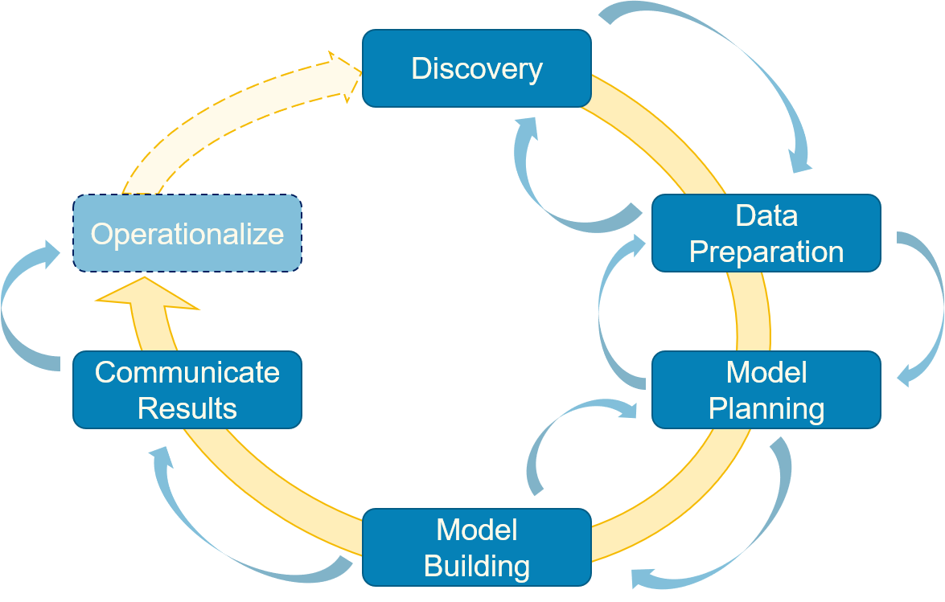
PROJECT WORKFLOW

Slide 3
INTRODUCTION
The credit risk prediction helps financial institutions and landers to:
Make informed decisions about extending a credit to induals. By allowing them to assess the payment capacity of the borrowers and avoid risk lending situation.
Mitigate the risk of loss by identifying high-risk borrowers and take appropriate measure to reduce exposure.

Slide 4
DATA ACQUISION
Title:Credit Risk Analysis for extending Bank Loans
Name: bankloans.csv
File type : CSV
Volume : 42.07KB
Source: Kaggle

Slide 5
DATA DESCRIPTION
Age : Age of the Customers
Ed : Education Level
Employ: Work Experience
Address : Address of the Customers
Income : Yearly income of the Customer
Debtinc : Debt to Income Ratio
creddebt: Credit to Debt ratio
Othdebt : Other debt
Default : Customer defaulted in the past (1= defaulted, 0=Never defaulted)

Slide 6
CLEANING PROCESS
Data understanding
Feature processing
Data type : all object and int & float
Missing values: 150 in default columns and used mean to fill them
Duplicated : 300 sum and less than 26%, all were dropped
Duplication, missing and type

Slide 7
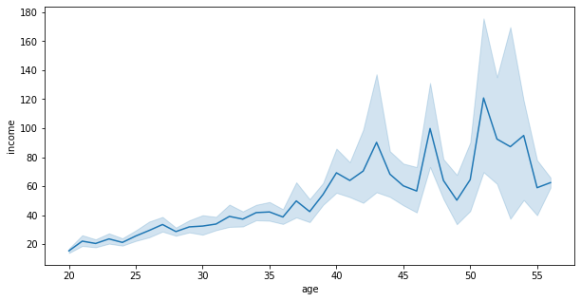
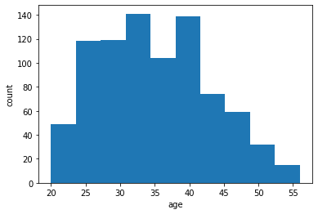
EXPLORATION AND DATA ANALYSIS
Age analyse: The age of customers started at 20 and drop at 55
relationship between income and age shows customer’s income increased with age, due to seniority or work experience

Slide 8
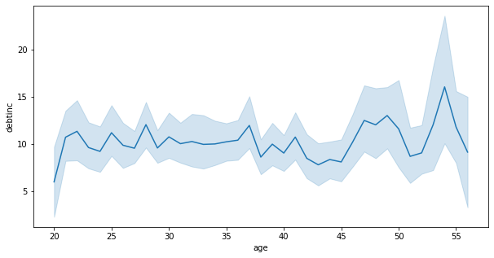
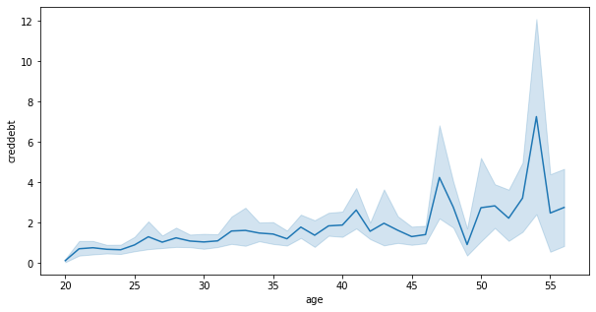
EXPLORATION AND DATA ANALYSIS
Age and debt to income ratio relationship shows that in most the case income & debt a correlated, both increase at 45 and drop at 55 this due to responsibilities that age can bring such as family care and so on.
Credit to debt ratio and age relationship provided insight of credit utilization by age, we can notice that utilization is high from 45 to 55 age

Slide 9
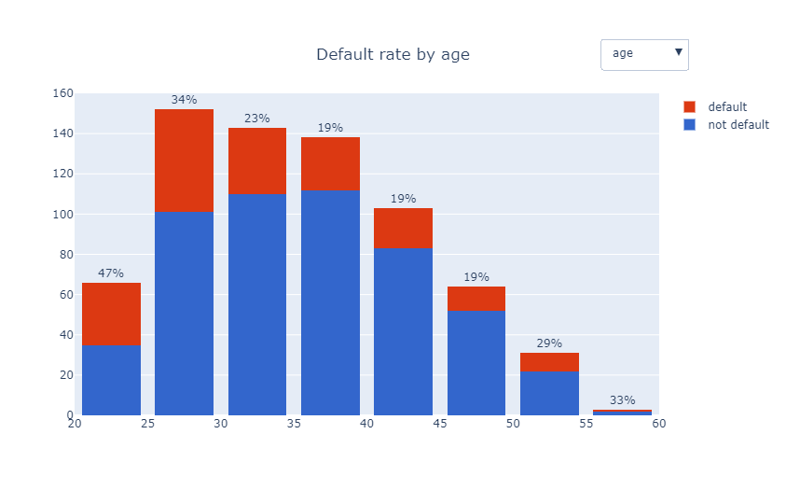
EXPLORATION AND DATA ANALYSIS
Default rate by age shows that most young age a likely to default, the rate is between 23% to 47%
The experiment

Slide 10
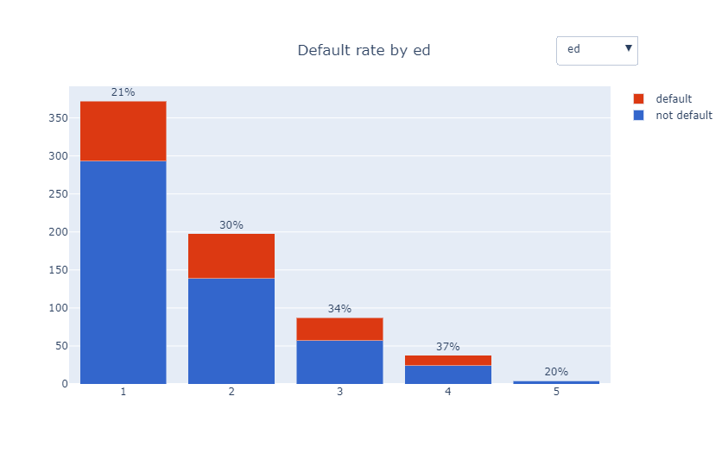
EXPLORATION AND DATA ANALYSIS
The default rate is very high to the customer with low education level

Slide 11
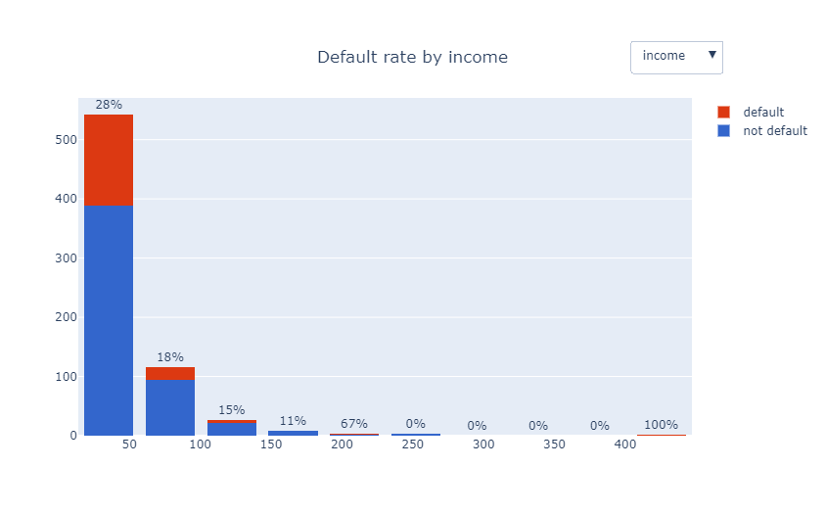
EXPLORATION AND DATA ANALYSIS
Customers with income less than $50k have high rate of default

Slide 12
DATA MODELING
Logistic Regression
Random Forest
Support Vector Machine(SVM)
K-Nearest Neighbors(KNN)
Decision Trees
Models used

Slide 13
All Models Results
Model | Hyperparameters | Recall Default | Precision Default | Train accuracy | Validation accuracy | Notes
Log Reg | olver='lbfgs',penalty='none',max_iter=1000 | 26% | 62% | 81% | 80%
Random Forest | Optimized parameters | 23% | 53% | 100% | 78%
Random Forest | estimator=rfc,X=X_train_sc,y=y_train,cv=5 | 81% | 86% | 81% |  | 81% accuracy with 5 times cross validation
Support Vector Machine | N/A | 13% | 56% | 83% | 78%
Support Vector Machine | C=1.2,gamma=0.4,kernel='rbf', Cv=5 | 21% | 57% | 89% | 79% | GridSearchCV the best model
K-Nearest Neighbors | N/A | 38% | 43% | 87% | 75%
K-Nearest Neighbors | Best K value, Best value of k: 11 with validation accuracy of 0.79 | 18% | 47% | 82% | 77%
Decision Trees | Optimized parameters | 31% | 36% | 99% | 73%
Decision Trees | max_depth_values = range(1, 20), best value =1, best accuracy=78% | 0% | 0% | 78% | 78% | Overftting

Slide 14
TESTING THE BEST MODEL ON THE TEST DATA
Train accuracy : 77%
Validation accuracy:77
Default recall : 16%
Default precision:82%
Paid loans recall :98%
Paid loans precision: 77%
The best model Optimized DecisionTrees.

Slide 15
RESULT INTERPRETATION AND BUSINESS RECOMMENDATION
The model is predicting 16% of loans default, and 82% of that number will be permanently defaulted.
The model prediction 99% of the loans extended will be paid and this might be due to the data imbalance.
The age, income, work experience and education level should be taken into consideration when approving a loans.
lenders should consider both customers high-risk and low-risk. Provide more loans and in best interest rate for low-risk and high interest rate for high risk customer.

Slide 16
Conclusion
In conclusion, credit risk prediction is crucial for informed decision making, risk management, profitability, regulatory compliance, customer relationship management, portfolio diversification, and economic stability.
It enables lenders to assess creditworthiness accurately, reduce risk, and make responsible lending decisions, benefiting both the lenders and borrowers.

